Slide 1
Pavement Management
2018 Section Engineers’ Meeting
February 2018
Chad Shive

Slide 2
PMS now a module in OMS
Same link used for OMS can access PMS data
Web only, from KYTC network
District Coordinator requests access just like OMS
Send emails to chad.shive@ky.gov

Slide 3
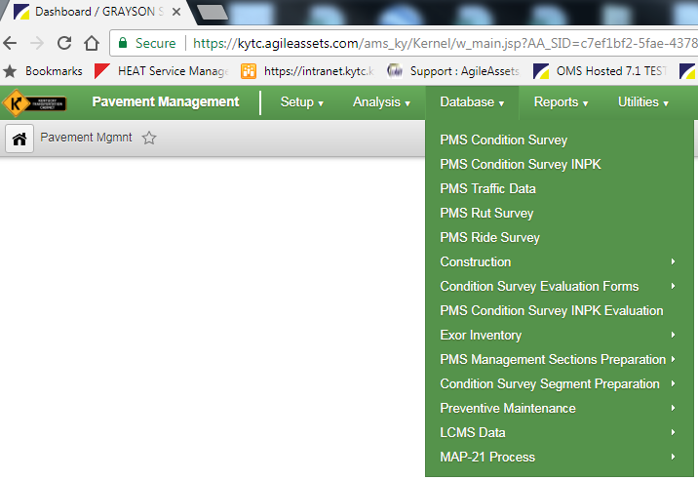
PMS Module

Slide 4
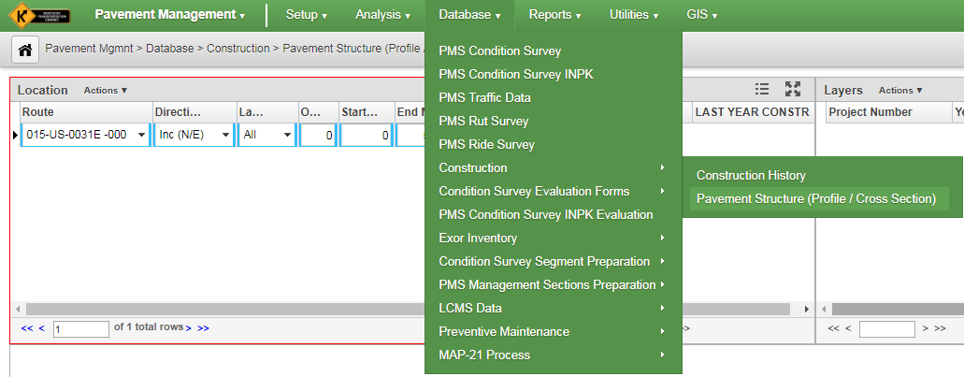
Pavement History

Slide 5
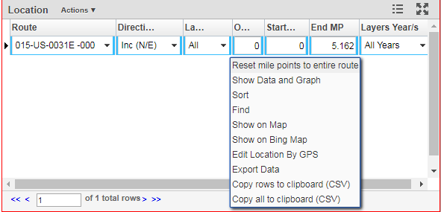
Pavement History

Slide 6
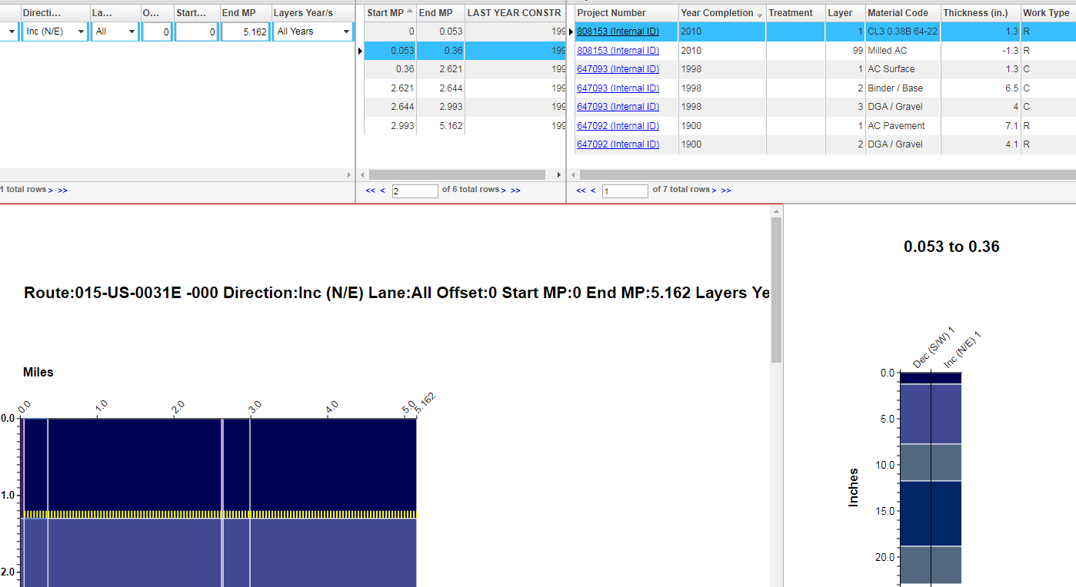
Pavement History

Slide 7
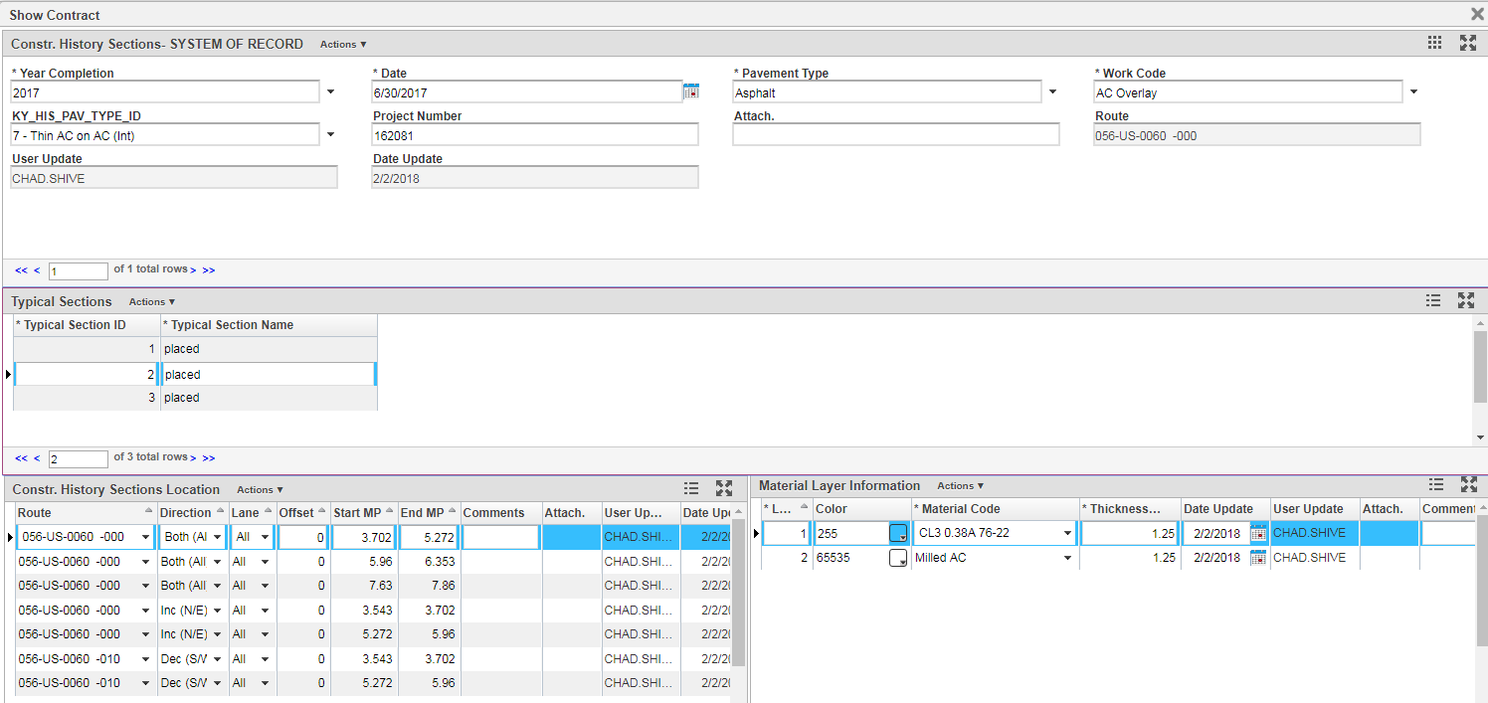
Pavement History

Slide 8
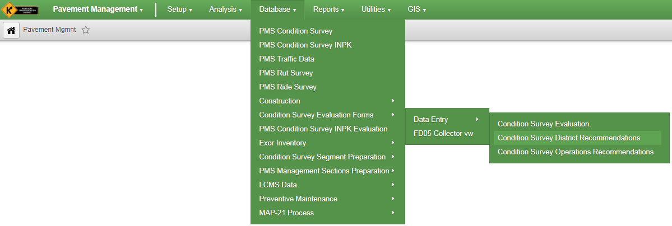
Condition Survey Estimates

Slide 9
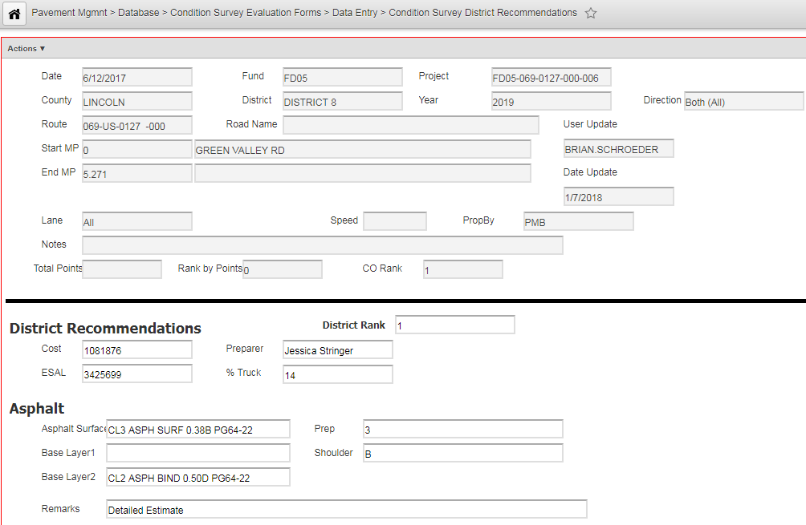
Condition Survey Estimates

Slide 10
Laser Crack Measurement System (LCMS)
Captures more factors
Objective assessment of pavement condition
Easier
Faster

Slide 11
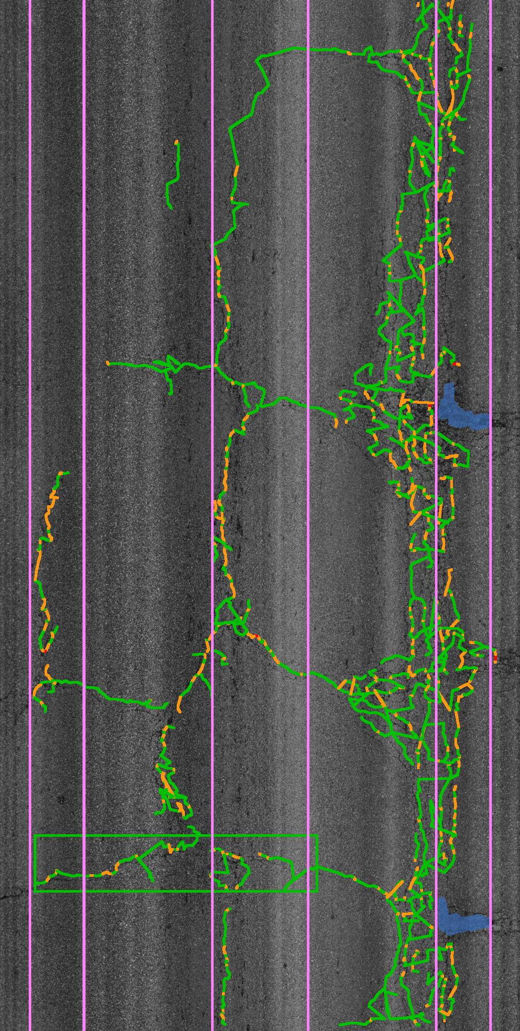
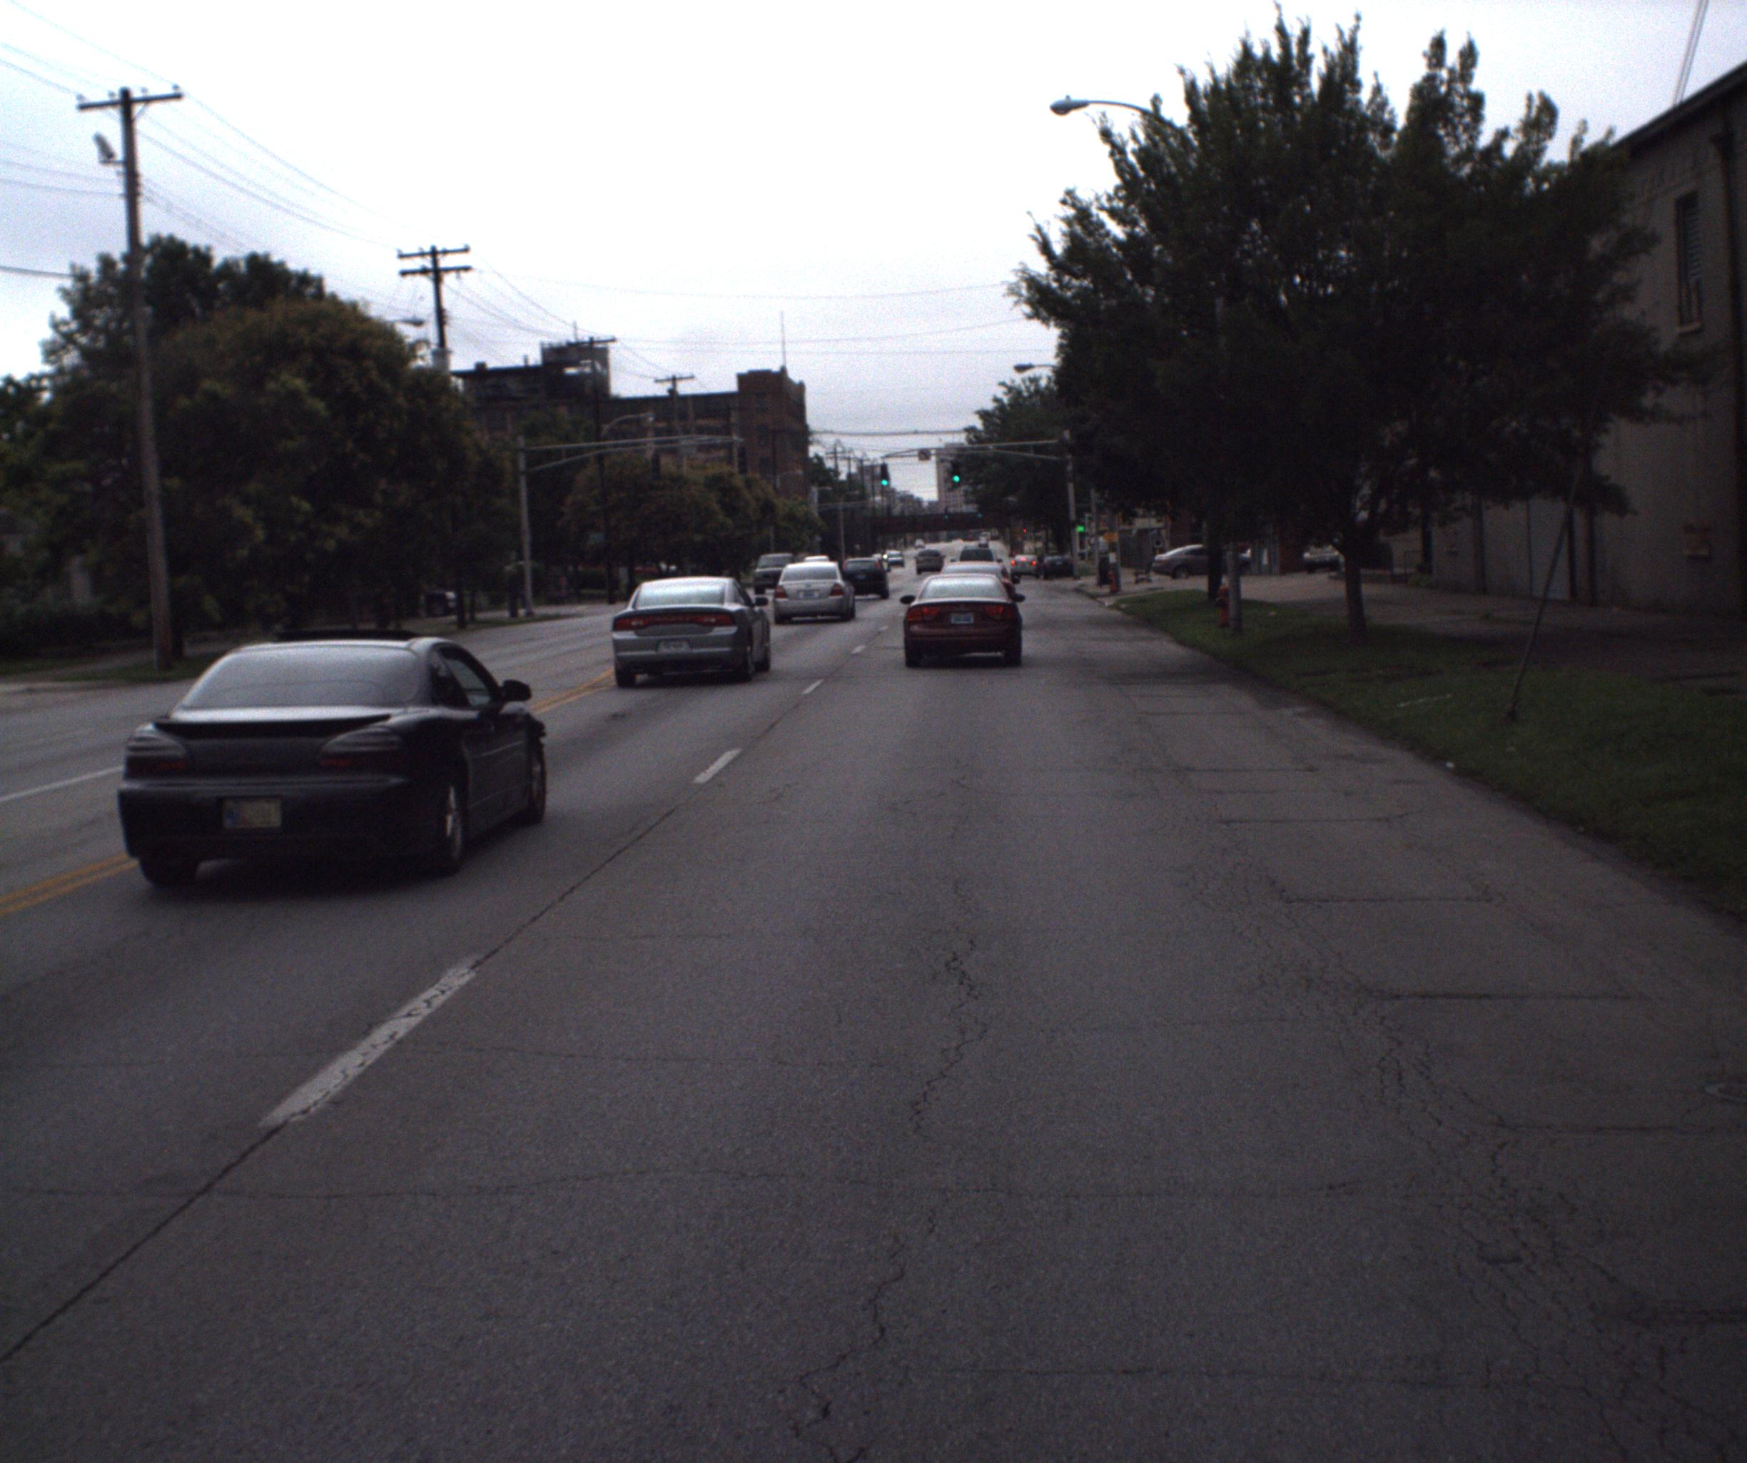

Slide 12
Integrating Research with Pavement Management
Collect pavement condition data in the past planning cycle
Run regression models to predict distress indices
Perform AHP analysis for weights for criteria
Calculate composite condition index for all road segments
Rank all projects based on composite condition index

Slide 13
What do we want from this data?
Pavement Condition
Prioritized Pavement Worklist
Condition Forecasting and Treatment Strategies
Incorporation of all treatment strategies into solution

Slide 14
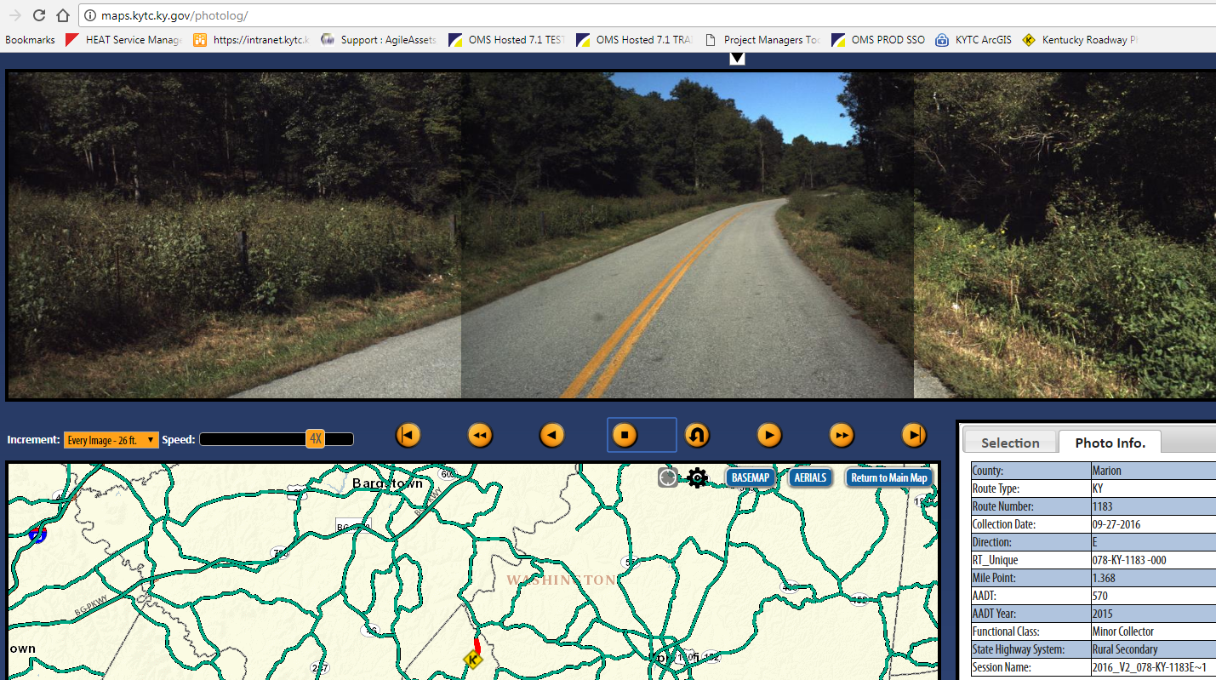

Slide 15
Wrap up
Request PMS access through your OMS Coordinator
Use Photolog: http://maps.kytc.ky.gov/photolog/
Contact Chad Shive for more info on PMS
https://fsds.ky.gov/adfs/ls/IdpInitiatedSignon.aspx?loginToRp=https://kytc.agileassets.com

